Slide 1



Taxi-time prediction
September 29th, 2020

Slide 2





About us
Akhila Vangara
Leon Leitao
Marc Vigneron
Pragya Singh
Romain Besombes
akhila.vangara@hec.edu
leon.leitao@hec.edu
marc-samvath-philippe.vigneron@hec.edu
pragya.singh@hec.edu
romain.besombes@hec.edu
Masters students at X-HEC Data Science for Business

Slide 3

Agenda
Problem definition
Opportunities offered by a precise forecast of taxi-out time
Our results: a more accurate model than the existing one
Main drivers of the taxi-out duration
Next steps – scope for improvement

Slide 4
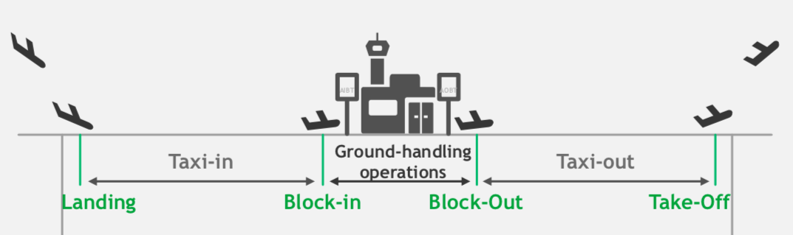
What is the taxi-out (TO) time?
1
AOBT
ATOT
Taxi-out time (TO) is the time window between the moment the airplane starts moving from its dock i.e Actual Off-Block Time (AOBT) to the moment it takes off, i.e. Actual Take-Off Time (ATOT)

Slide 5

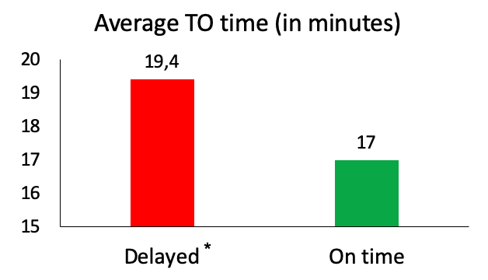

Why is it important to precisely forecast the TO time? (1/3)
2
Improve the customer experience / satisfaction by reducing the number of flights delayed
72% of the airplanes left the dock after the scheduled datetime
6% of the airplanes have a TO time more than 30 minutes
Being able to precisely predict the TO will help airports and airlines improve their on-time performance by adjusting their onboarding time
* Delayed means AOBT > Scheduled Datetime
Notes:
As Marc mentioned, the objective of this project is to accurately predict the Taxi Out time for every aircraft. Indeed, there are 3 main reasons for which this is an important challenge for airports to be as accurate as possible in this prediction
First, it has to do with the overall customer satisfaction as a high TO is often tantamount to a high probability of delay. We found that 6% of the airplanes have a TO superior to 30minutes which is very likely to create a delay at the end of the journey. We found that 72% of the airplanes left the dock after the scheduled datetime and this planes have a higher TO than the planes that left the dock on time as highlighted by graph on the left. This is probably due a difficulty of the airports to deal with traffic and prioritization of planes in case of delay.
To tackle this issue of delays (and also of traffic optimization), airports need to have an accurate prediction of the future taxi out times. It will help them to spot the future risks of high TO. If they manage to spot these high taxi out times in advance they will be able to take measures to reduce this taxi out time such as adjusting their onboarding time or giving the priority to the corresponding planes in the queue for the take off.

Slide 6
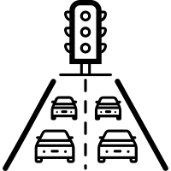

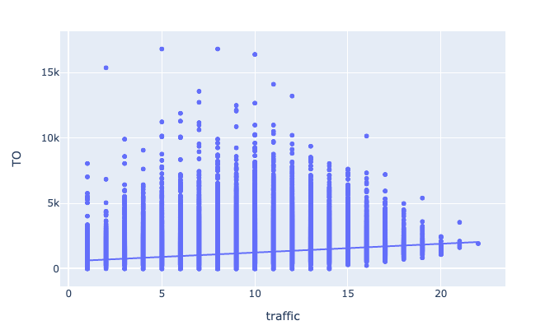
2
Why is it important to precisely forecast the TO time? (2/3)
Better optimization of the ground airplanes traffic and bottlenecks resulting in:
Reducing costs associated to manual ground operations through more automation
Increasing the overall capacity of the airport especially during peak hours
Linear regression of TO as a function of the traffic
OLS trendline
TO = 67 * traffic + 564
R²=0.20
→ Adding 1 airplane in the total traffic will make TO of the following airplanes 1 minute longer*
TO (in seconds)
Traffic
Having a precise prediction of TO is necessary to better handle traffic during peak hours which will finally also help reducing the average TO
*Under the hypothesis of causality
Notes:
The second opportunity offered by a more accurate prediction of Taxi out time is to help airports in better optimizing the ground airplanes traffic and reduce bottlenecks at specific runways which will help reducing the costs associated to manual ground opreration and increase the overall capacity of the airport.
Indeed, as highlighted by the graph, we found with a linear regression, that traffic is very correlated with the Taxi out time and that 1 additional airplane in this traffic will cause 1 more minute of Taxi out time.
Having a precise prediction of TO is necessary to better handle traffic during peak hours for example through more automatization by changing the AOBT times of other airplanes to avoid high traffic or by allocating more ressources to ground operations during peak hours.

Slide 7


2
Why is it important to precisely forecast the TO time? (3/3)
Reducing the airplanes’ fuel consumption resulting from airplanes’s idle time at runway entrance
Reducing the fuel variable costs
Reducing the emissions of CO2
Boeing 747 example*: 17 minutes of taxiing:
= 1250 liters of kerosene
= 13k €
*Source: Israel industry aerospace (IAI)
Notes:
And finally, a better prediction will also help airports and airlines in reducing the airplanes’ fuel consumption resulting from the airplaness waiting at runway entrance
Which will make airlines save money and reduce their CO2 emissions
Just as an example, a study from the Israel Industry Aerospace showed that a Boeing 747 consumes 1250 lites of kerosene when taxiing during 17 minutes which represents 13 thousand euros.

Slide 8
3
A problem involving many different external variables
Higher traffic than usual (~10 aircrafts)
Dangerously Windy and Mostly Cloudy Weather
Unusually long taxi time may have several different causes
Many outliers: 2.6k airplanes had a TO more than 1 hour (~0.5% of the observations)
The Model needs to account for this complexity and take into account external variables

Slide 9
3
Our model outperforms the one currently used (rolling average)
Compared to the Moving Average that almost always predicts the same value, our model has a lot of variance in its predictions which reflects the variance of the true TO values
The errors done by our model are on average lower than the errors done by the Moving Average

Slide 10
3
How does the accuracy of the prediction vary depending on TO values?
Still some room for improvement in dealing with high TO outliers
Average MAE (in minutes)
Real TO (in minutes)
Our model constantly beats the accuracy given by a rolling average for small TO
*3 extreme outliers have been removed

Slide 11
3
A better performance (RMSE and MAE)
 | Rolling Mean | LGBM
RMSE | 482.2 | 431.52
MAE | 321.94 | 250.17
1st Quartile errors | 119.71 | 83.24
3rd Quartile errors | 423.24 | 308.38
Notes:
A
Define RMSE, MAE, 1st Quartile errors, 3rd Quartile errors

Slide 12
3
Why should you use our model?
Our model
Rolling Average
Robustness to extreme conditions (weather, traffic…)
Real time prediction: being able to predict TO every minute
Growing performance

Slide 13
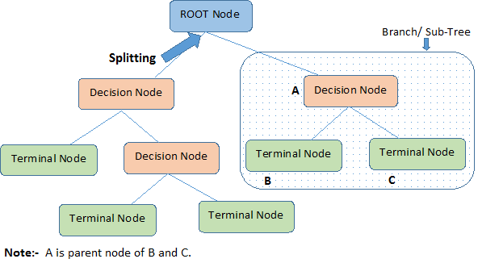
3
A background on Tree Based Models
The topmost decision node in a tree which corresponds to the best predictor called root node
A decision node has two or more branches, each representing values for the attribute tested
Terminal node(or leaf node) represents a decision on the numerical target.
Notes:
Tree-based algorithms use a fundamental unit known as a decision tree. A decision tree can be used to visually represent the “decisions”, or if-then rules, that are used to generate predictions
For our model, the ‘splitting’ was performed on variables such as ‘traffic(N)’ or ‘wind bearing’.
The root node in our case was the Traffic, as it was the best way to split the data and was highly correlated with the taxi out time.

Slide 14





4
We use different variables to achieve this good performance
Traffic
Weather
Driving
Distance
Aircraft Characteristics
Date Time
Characteristics
N: For a given plane x, N_{x} represents the number of planes taxiing at time AOBT_{x}(inc)
•Precipitation
•Windspeed
•Cloud cover
•Visibility
•Pressure
•Temperature
•Humidity
•Euclidean distance between every stand and the runway
•Length
•Wingspan
•n° Engines
•Model
•Movement type
Cyclic transformation of the following time variables:
•Hour
•Day of the week
•Month
•year
Q: For a given plane x, Q_{x} represents the number of planes taking off while x is taxiing.
•Combination of different stands and runways are key factor
Notes:
P

Slide 15
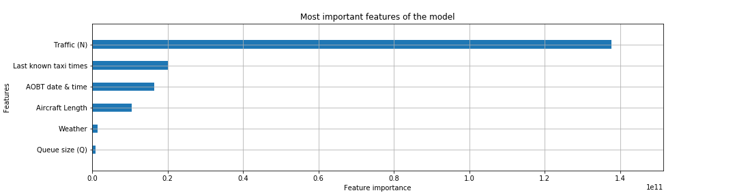
4
The most important variables
Traffic is the most significant out of all the features
Taxi times of recent flights that took off also help improve model performance
Aircraft Type and Weather variables have a comparatively lower importance
Notes:
P

Slide 16
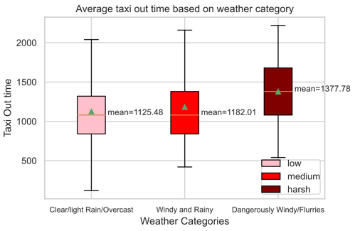





4
An example: weather
Qualitative Variables
Quantitative Variables
Wind Bearing & Wind Speed
Precipitation
Cloud Cover
There is a correlation between the weather condition and Taxi-out time. The worse the weather, the more the Taxi-out time
These Quantitative variables proved to be useful in prediction of the Taxi-out time
Notes:
P

Slide 17
4
Traffic: the most important variable
We define traffic as the number of planes currently taxiing, i.e. that have left their docks and not yet taken off
Most important features of our model
Most highly correlated feature with the taxi-out time (approx. 0.45)
Notes:
M

Slide 18
5
Future scope of improvement
While our model is clearly superior to the method currently used, here are some ways to improve it:
Train the model continuously instead of using a fixed train dataset, i.e. extend the train dataset to all flights that have taken off
Get additional information on airport layout and operational details, i.e. exact distance, sharp turns, runway operational organisation, etc.
Get information about incoming planes instead of using only planes that are due to leave
Explore other models: promising results with Extra Tree
Notes:
M

Slide 19

Thank you for you attention
Any questions?

Slide 20
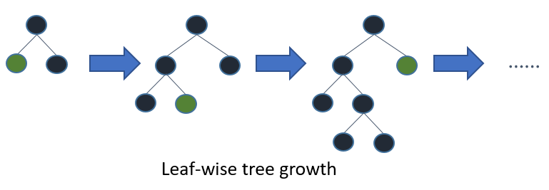
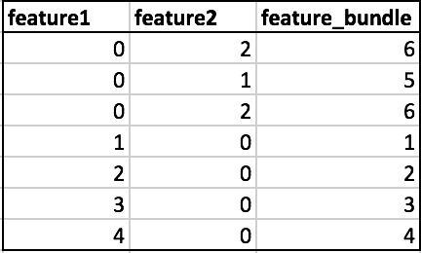
Annex:A background on LightGBM
Leaf wise tree growth as opposed to level wise growth
EFB(Exclusive Feature Bundling) merges the features to reduce the training complexity.
Much faster training time without compromising on the performance.
Notes:
We generally work with high dimensionality data. Such data have many features which are mutually exclusive i.e they never take zero values simultaneously. LightGBM safely identifies such features and bundles them into a single feature to reduce the complexity

Slide 21
Annex: Q and N
For a given plane i, N_i represents the number of planes taxiing at time AOBT_i, including i
For a given plane i, Q_i represents the number of planes taking off in the interval [AOBT_i, ATOT_i], i.e. the number of planes taking off while i is taxiing.

Slide 22
Annex: Q and N
For a plane i, Q_i represents the number of planes taking off in the interval [AOBT_i, ATOT_i]
Problem: ATOT_i is unknown at AOBT_i, as well the ATOT of flights still taxiing and not having taken off.
Solution: For all flights j compute the rolling mean RM_j of the TO‘s of the last n flights that have taken off. Then for flight i, compute the number of flights with AOBT_j + RM_j in [AOBT_i, AOBT_i +RM_i]

Slide 23
Annex: Q and N
To compute N:
order the flights chronologically by AOBT
For each flight i, count the number of flights with an earlier AOBT
Of those flights, discard the ones with an ATOT that is also earlier than AOBT

Slide 24
Our model outperforms the one currently used (rolling average
Average daily predictions of the TO with our model (LightGBM)
vs the 2 months Moving Average
TO predictions (in sec)
On average our model is better. It does not make constantly the errors on the same sign.

Slide 25
Models scores
3
 | Rolling Mean | Linear Regression | Lasso | LGBM | XGB | Extra Trees
RMSE | 482.2 | 436.64 | 435.34 | 431.52 | 431.98 | 430.34
MAE | 321.94 | 250.7 | 249.96 | 250.17 | 248.41
1st Quartile errors | 119.71 | 82.29 | 82.44 | 83.24 | 82.29
3rd Quartile errors | 423.24 | 306.82 | 305.47 | 308.38 | 305.6

